Slide 1
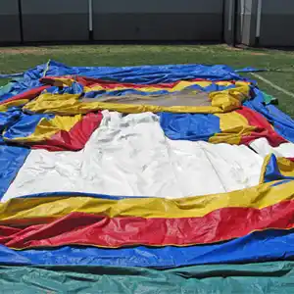
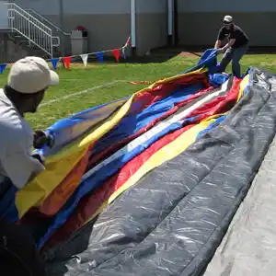
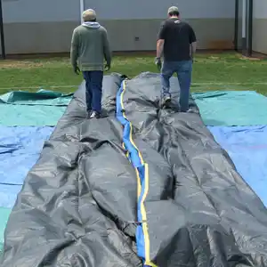
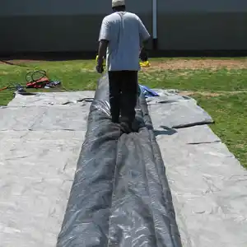
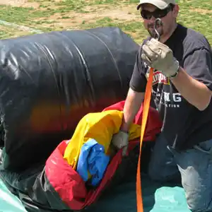
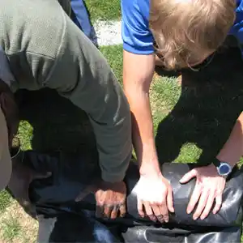
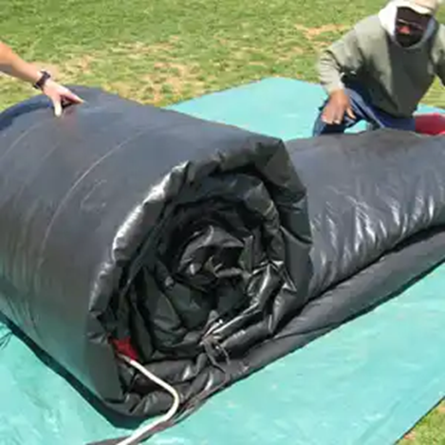
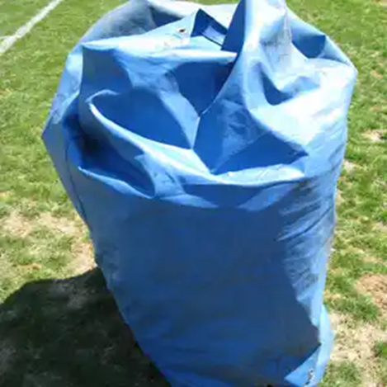
Photos for How to Roll an Inflatable:
1) Fold all material toward the middle of the Inflatable and find the bottom seams of the Inflatable.
2) Fold the Inflatable like a large bed sheet.
Be sure to tuck all colorful designs inside your folds
3) Fold sides in 2-3 feet lengthwise.
4) Continue to fold Inflatable from the outside-in
until folded layers overlap leaving a fold of 2-3 feet.
5) Tuck in any extra material. Leave ports out. Walk air out of the Inflatable by walking on the Inflatable towards the port.
6) Where the roll is to end- tuck in rope or strap 2-3 feet underneath Inflatable that is to be used for tying.
7) Begin rolling from the furthest point away from the
port, roll as tightly as possible. Keep the roll lined up,
tuck in any extra material.
8) Tuck in the ports. Tie off roll with rope or strap. Tuck in hoses Place in bag when applicable.
https://americanfamilyday.com/instructions/inflatable/

Slide 2
Safety Instructions / Operation 1) Adult supervision is required at all times. Never leave the Inflatable unattended or unwatched. 2) Most Inflatables only allow 4-5 Guests on the Inflatable at a time. (Check Inflatable Instructions) 3) Guest must remove shoes, pocket items, glasses, jewelry, etc. 4) Diving and flipping are strictly prohibited. No back flips, roughhousing, horseplay or bouncing against walls. Guests should not take unnecessary risks. 5) No food, drink, or gum on or in the inflatable.
*The Inflatable should not be operated if winds exceed 20 mph. *The Inflatable should not be used in rain or lightning conditions.
How to Set-up 1) Check ground for a flat level surface void of any rocks, sticks, pinecones, etc. (Anything that may puncture the bottom of the Inflatable). Also check height clearance for trees, power lines, or overhead obstructions. Tarps should be placed underneath all Inflatables before proceeding to Step 2. (Never operate the Inflatable on a hard surface without under padding (i.e., tarp).
2) Unroll the Inflatable in the direction you wish the Inflatable to face. 3) Unfold and Attach the Blower(s) to the “Port”. The “Port” is generally located in the very back or on the sides of the Inflatable. Tie off any additional “Ports” by turning the material clockwise and tying the Port to itself. (Rope can also be used to close off additional Ports. 4) Close All Velcro / Zipper compartments. 5) Attach heavy extension cord(s) from power source. (Designate One 20-amp fuse for each Blower. Generally, this equates to One 110-volt Outlet for each Blower.) Use 14 gauge or heavier extension cord(s) that extend No More than 100 feet from the Inflatable to the power source. (The lower the gauge number, the thicker the cord. Most household / garden extension cords are 16 gauge (Not Sufficient enough) and can harm the blower- reducing the air source to the Inflatable).
6) Turn the Power on. (Some Blowers have an On/Off switch located on the blower.) While the Inflatable inflates- Check to make sure no air is escaping vents or ports. 7) Check to make sure the Port (air hose) leading to the Blower is not twisted. 8) Secure the Inflatable by staking the unit on all 4 corners. Drive stakes halfway in at a 45-degree angle away from the inflatable. For larger Inflatables tie-outs will need to be staked.

