Slide 1
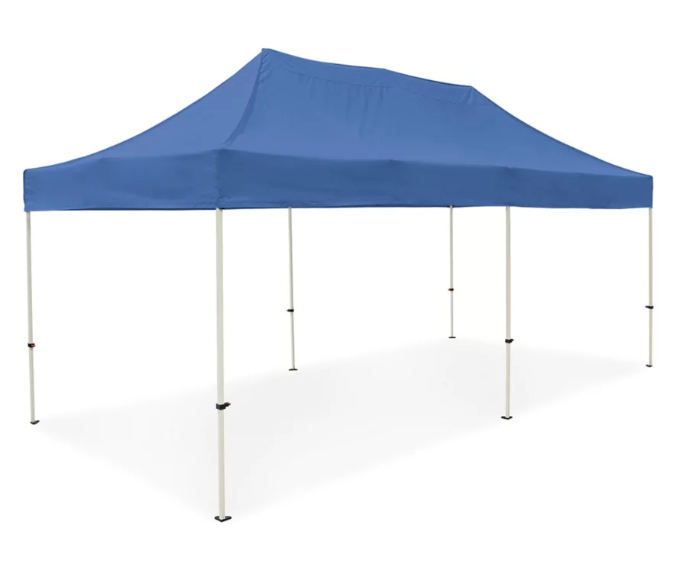
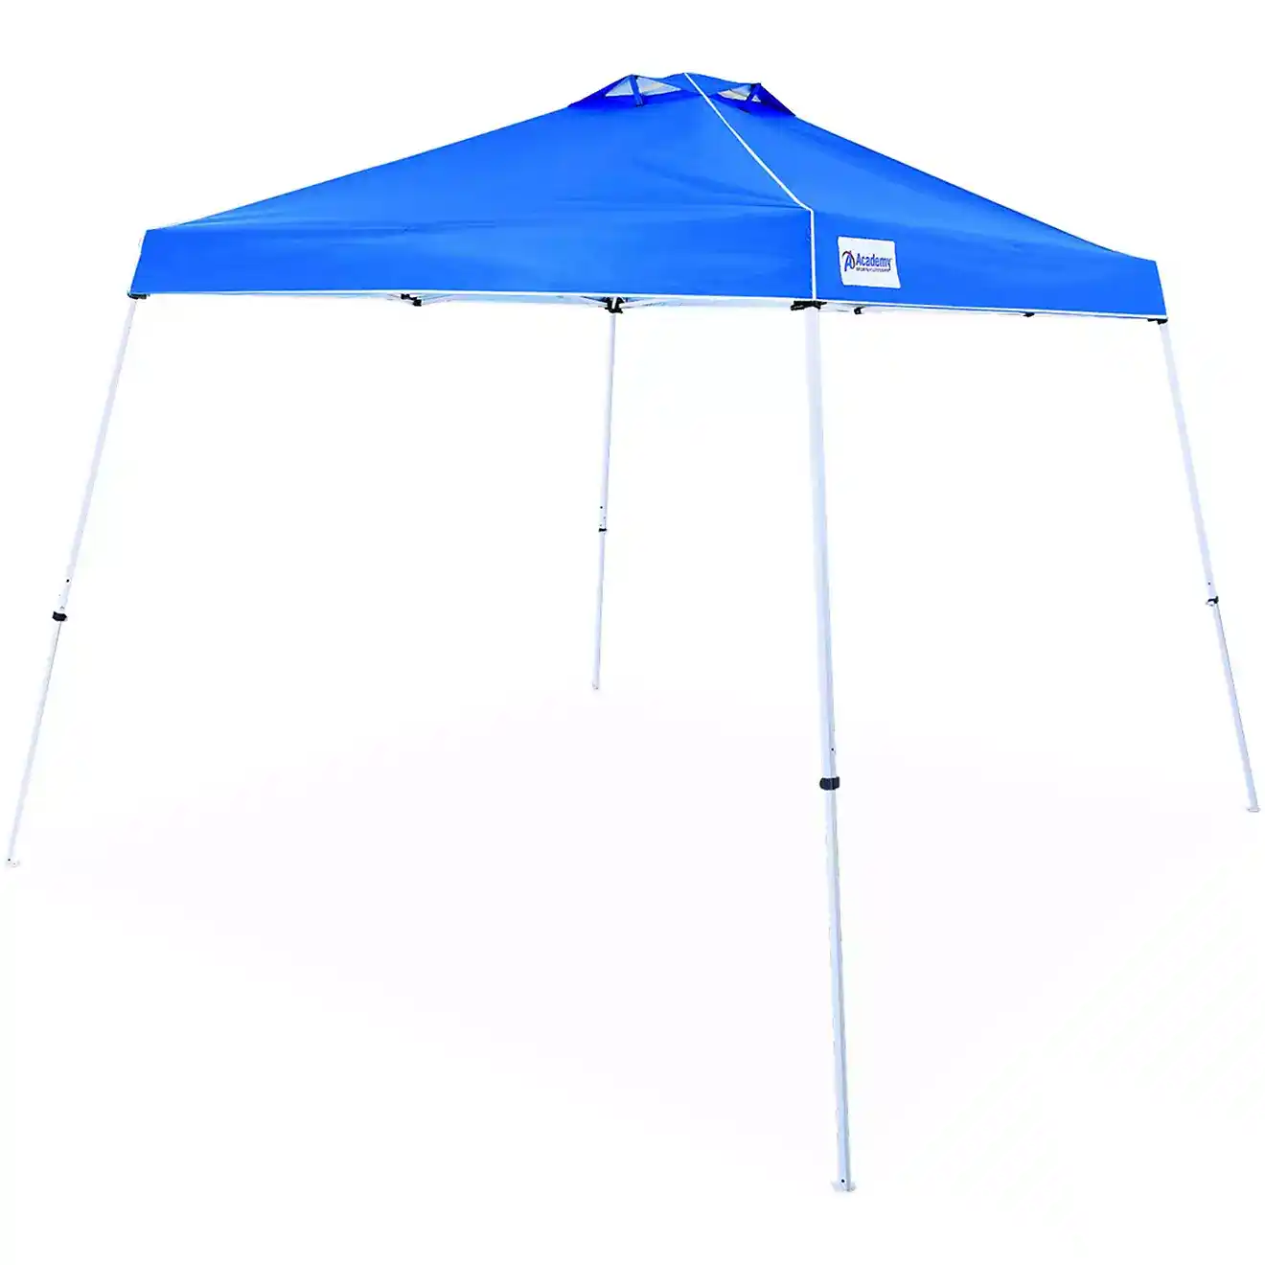
10x10 Canopy 20X10 Canopy
12x12 Canopy

Slide 2
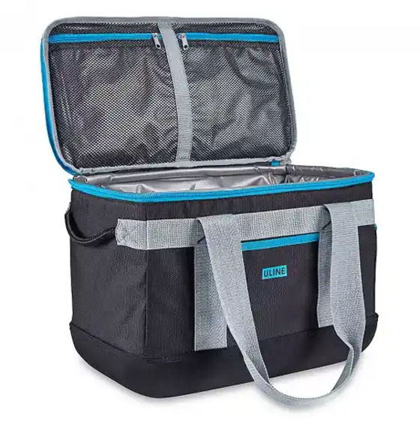
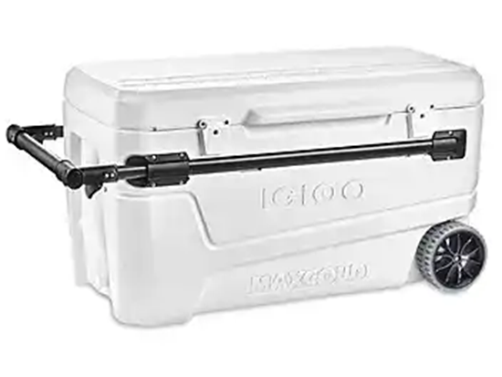
Uline Cooler (18” x 10” x 12”)
IGLOO ICE Chest Glide
110qt

Slide 3
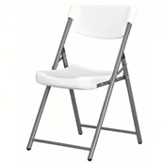
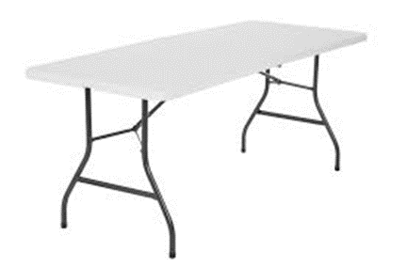
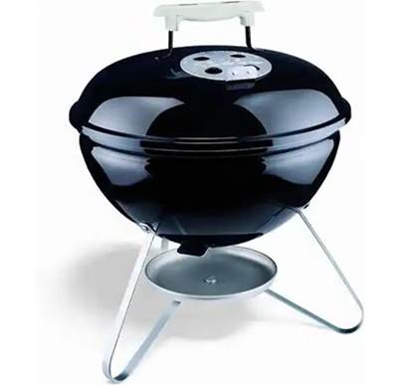
Plastic Folding Chair
Weber Grill (Charcoal)
Folding Half Table

Slide 4
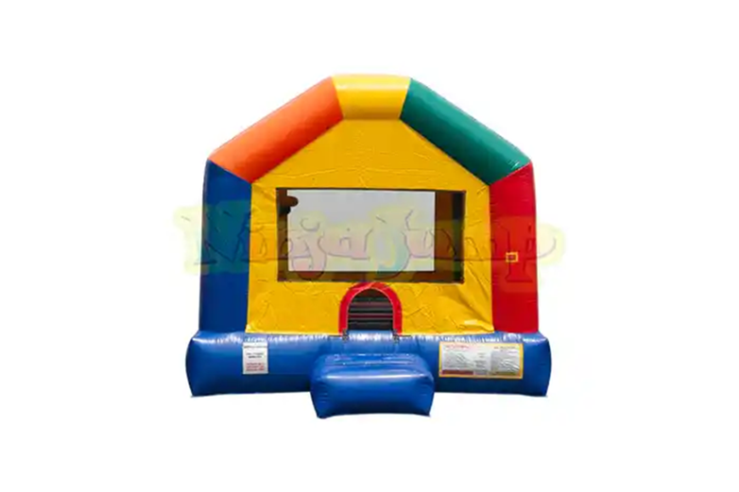
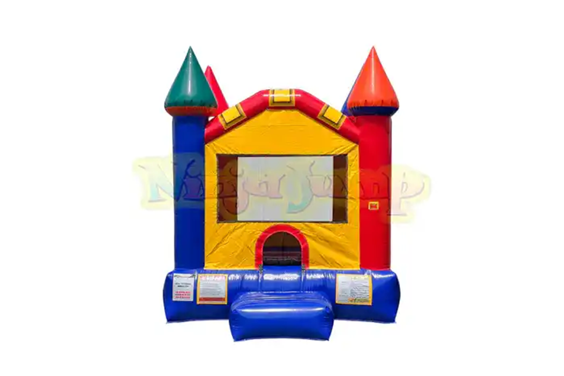
Small Castle Bounce House
(L 11’4 ’x W 10’4 x H 12’6)
Medium Fun House
(L 14’4 x W 10’4 x H 12’6)

Slide 5
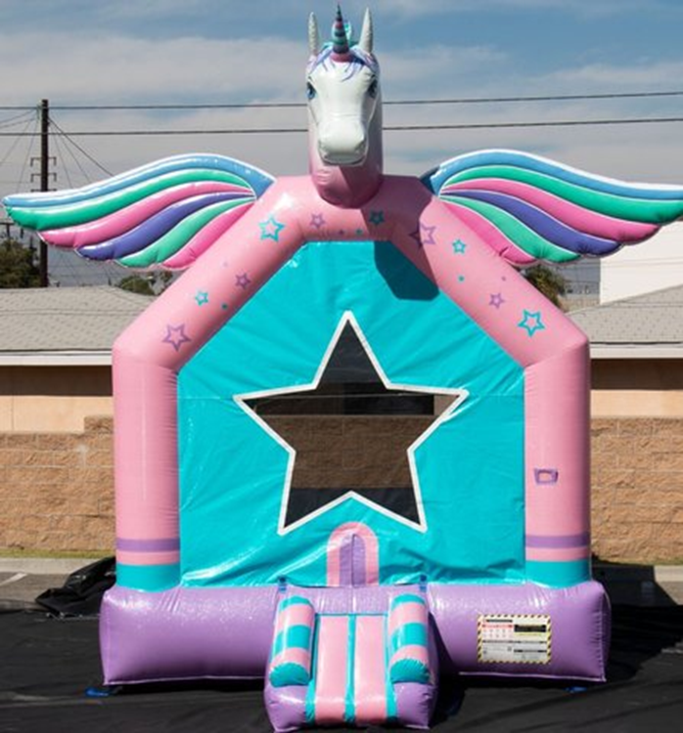
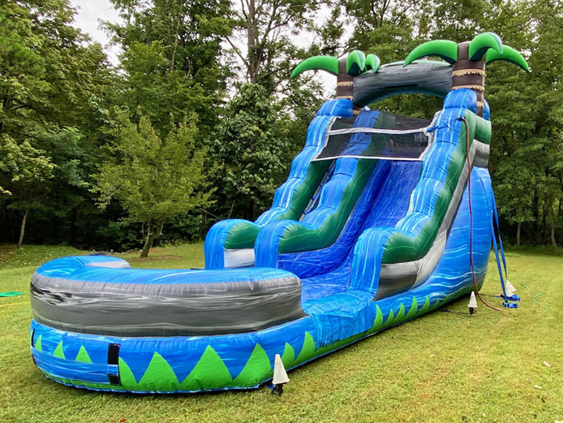
Unicorn Bounce House
(L 13’ x W 13’ x H 18’)
Blue Crush Slide
(L 20’ x W 9’ x H 20’)

Slide 6
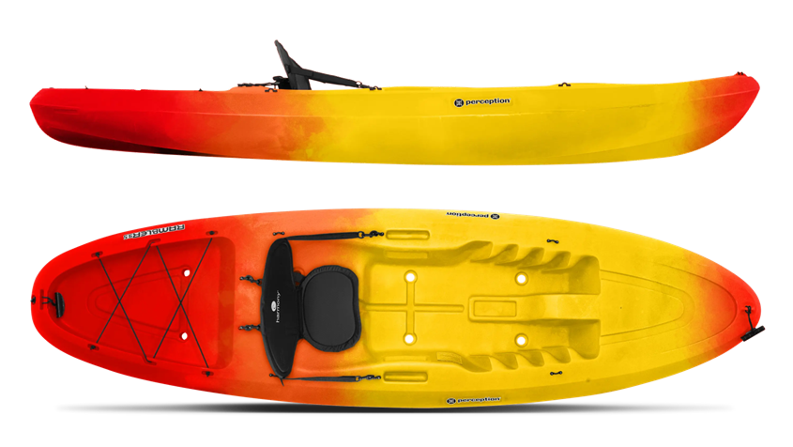
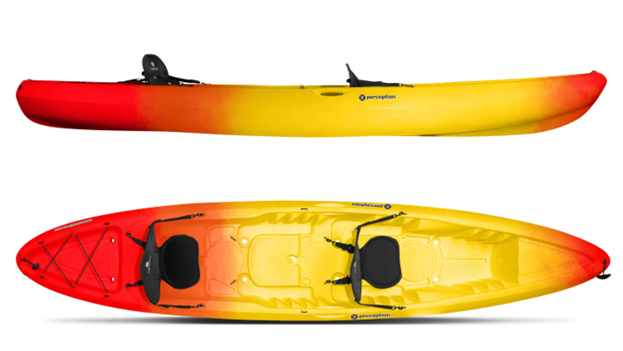
Single Kayak Rambler 9.5
Double Kayak Rambler 13.5

Slide 7
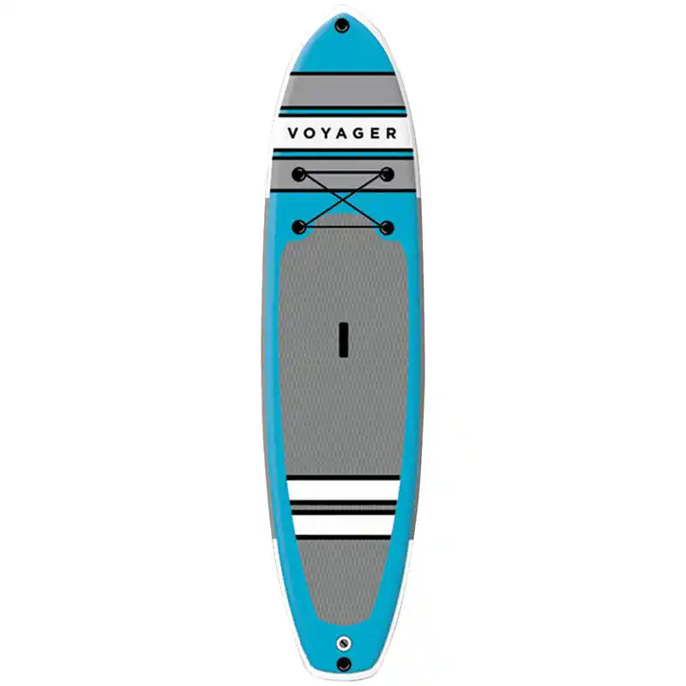
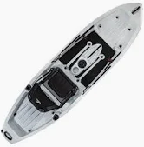
Stand Up Paddle Board
Single kiasen Fishing Kayak 10ft

Slide 8
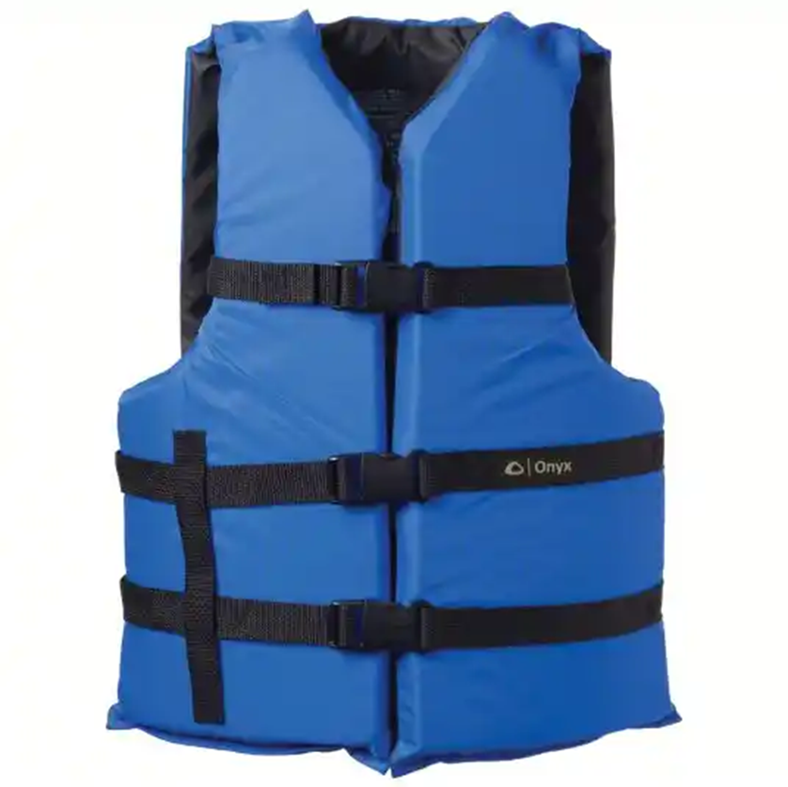
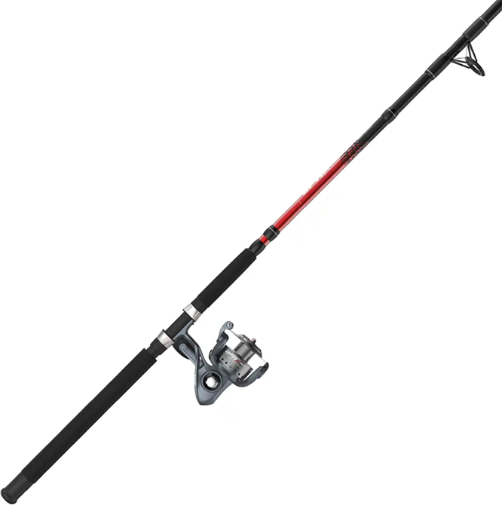
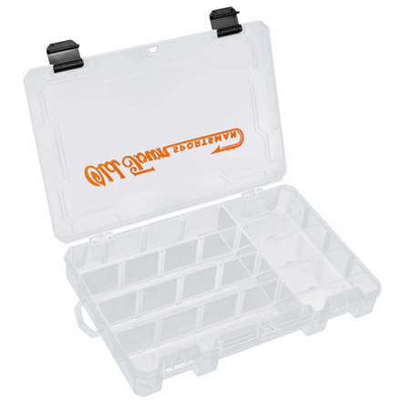
Optix 80 Reel 8ft Fishing Rod
PDF Life Vest
(INF/CHD 50LB)
(CHD 30-50LB)
(youth)
(universal)
(oversize)
Stocked Tackle Box

